Slide 1



EdTech Startup Analysis
View in Power BI
Last data refresh:
6/7/2022 10:58:31 AM UTC
Downloaded at:
6/7/2022 11:05:46 AM UTC

Slide 2
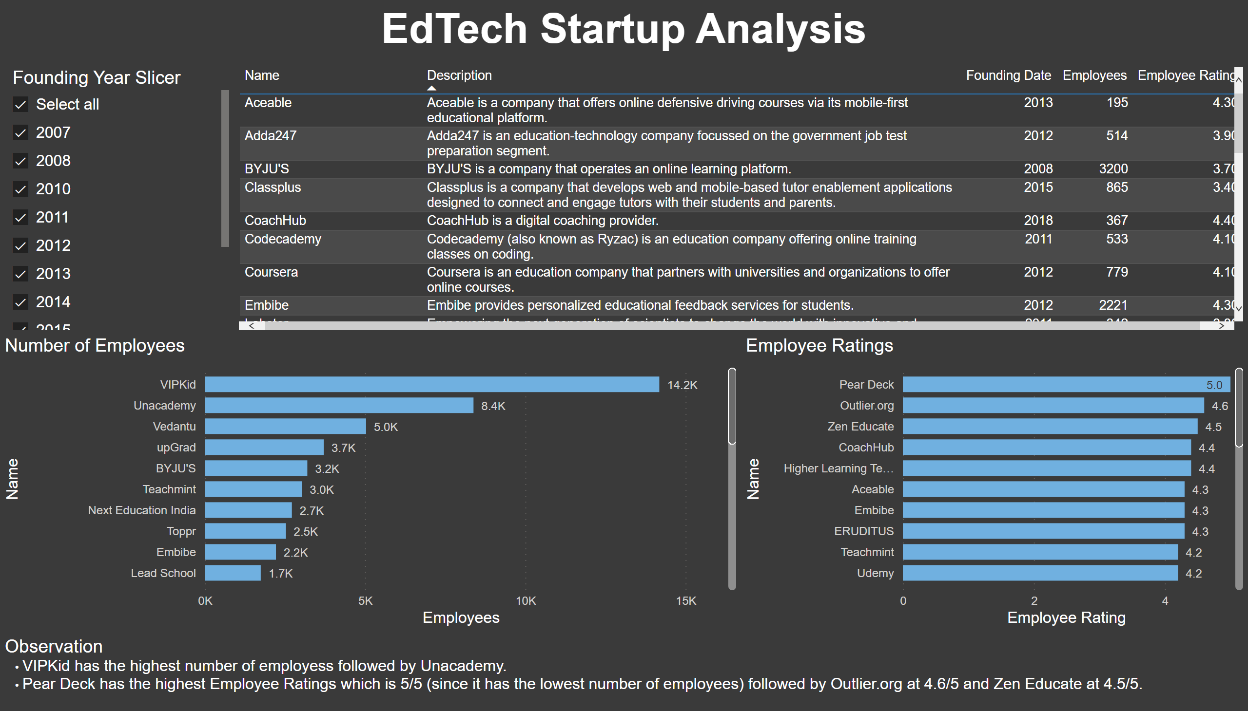
Part 1 Employee Data
Notes:
Number of Employees
No alt text provided
textbox
No alt text provided
slicer
No alt text provided
Employee Ratings
No alt text provided
tableEx
No alt text provided
textbox
No alt text provided

Slide 3
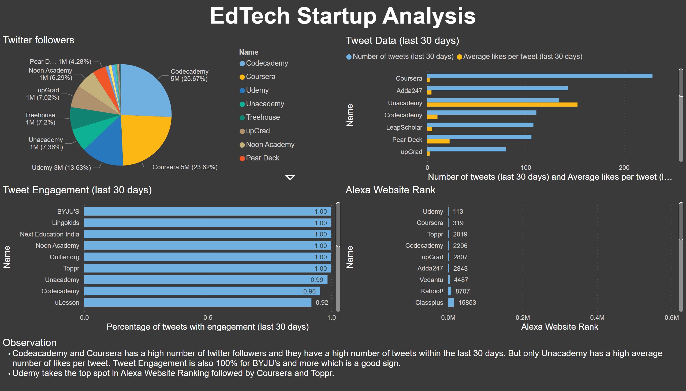
Part 2 Social Media Data
Notes:
textbox
No alt text provided
Tweet Engagement (last 30 days)
No alt text provided
textbox
No alt text provided
Twitter followers
No alt text provided
Tweet Data (last 30 days)
No alt text provided
Alexa Website Rank
No alt text provided

Slide 4
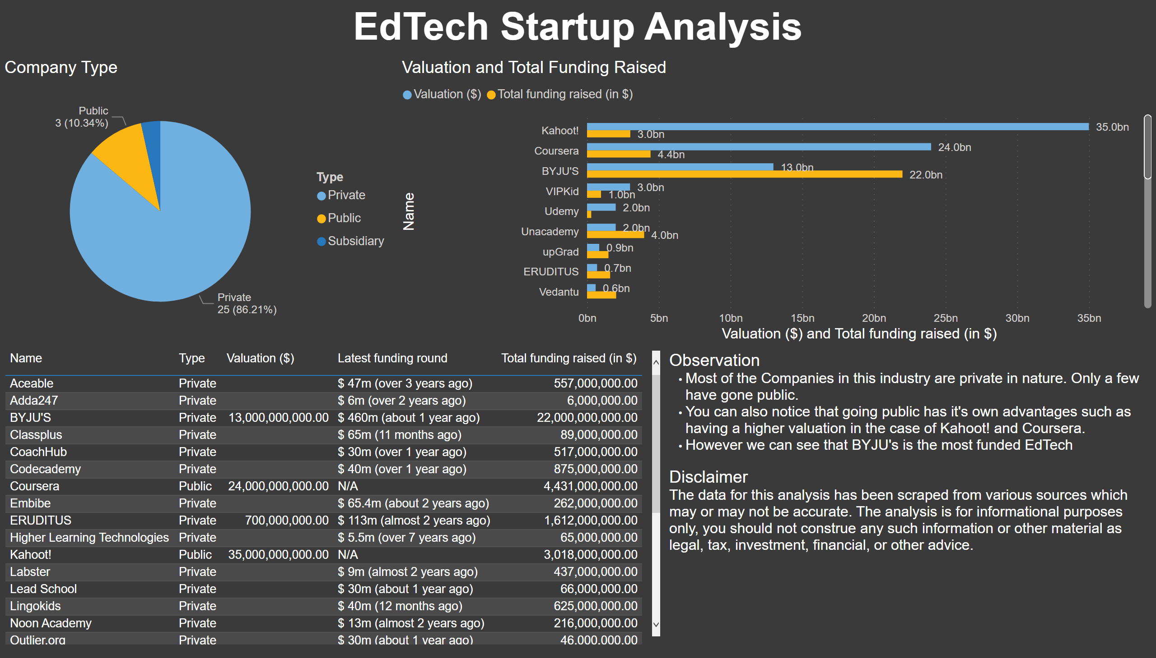
Part 3 Financial Data
Notes:
textbox
No alt text provided
textbox
No alt text provided
Company Type
No alt text provided
Valuation and Total Funding Raised
No alt text provided
tableEx
No alt text provided

Slide 5
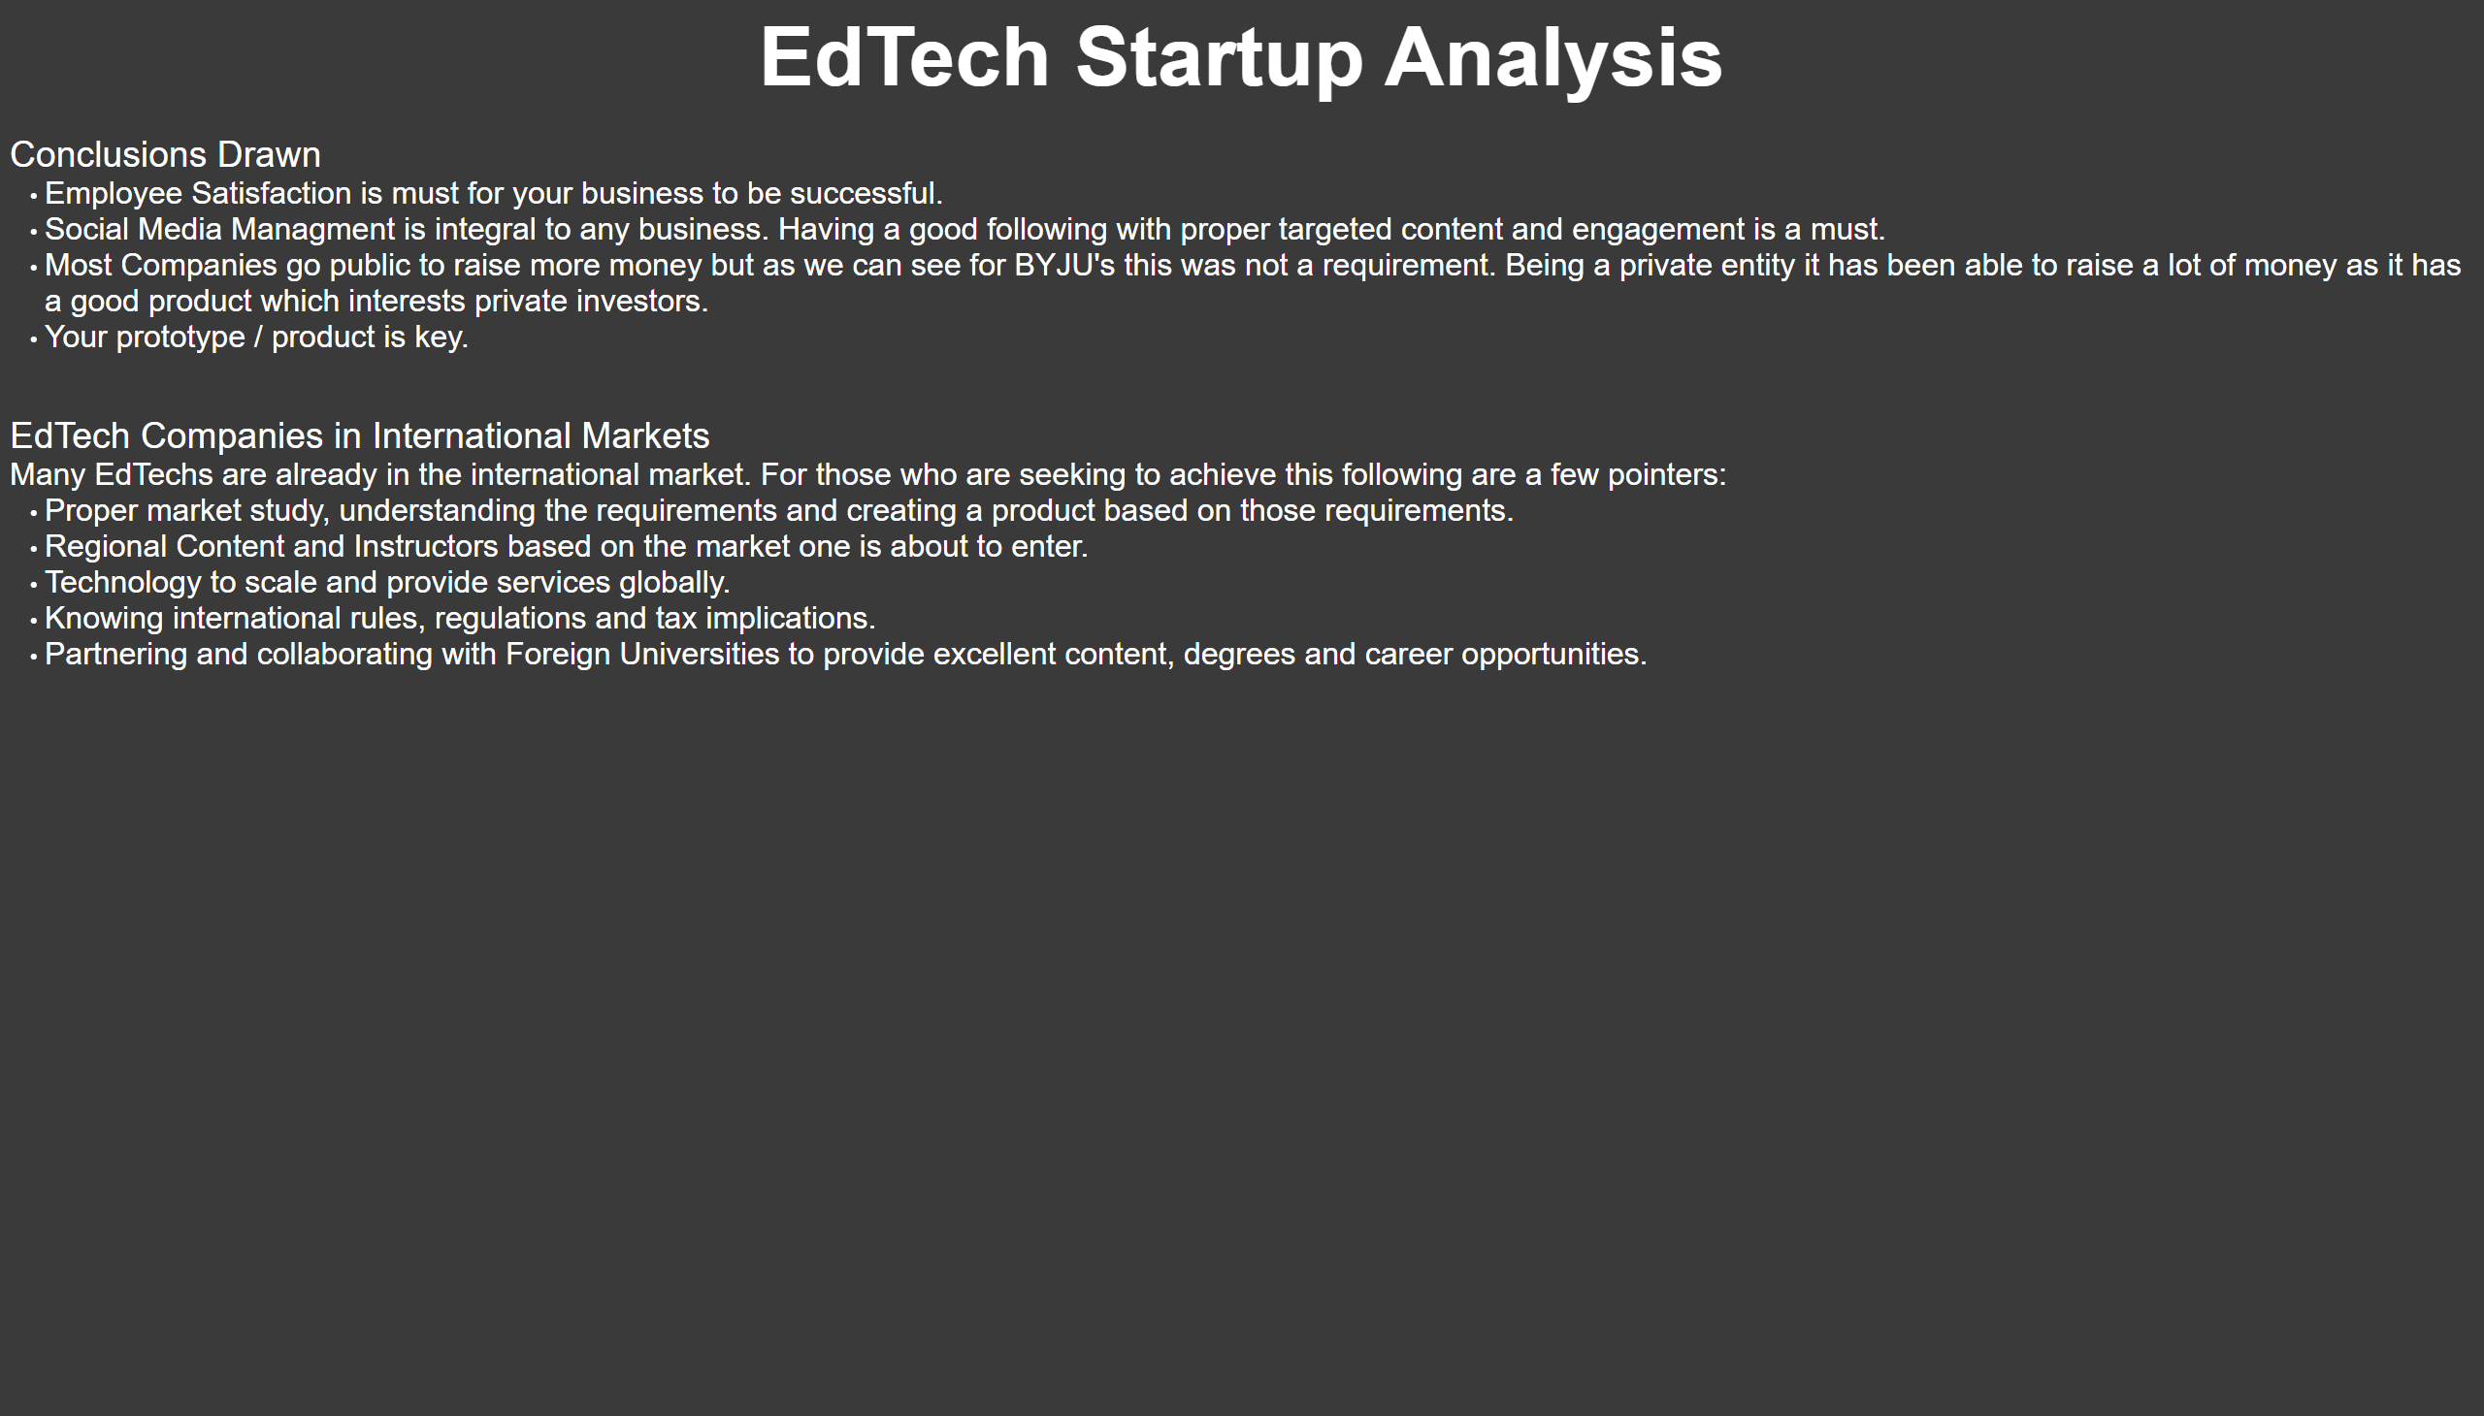
Part 4 Conclusion
Notes:
textbox
No alt text provided
textbox
No alt text provided

